Slide 1

AMCS1003 Software engineering
Group 4 : Logistics System
By Tan Kang Hong, Lau Jun Dian, Har Chun Wai,
Cheng Cai Jie & Nee Mei Yi

Slide 2
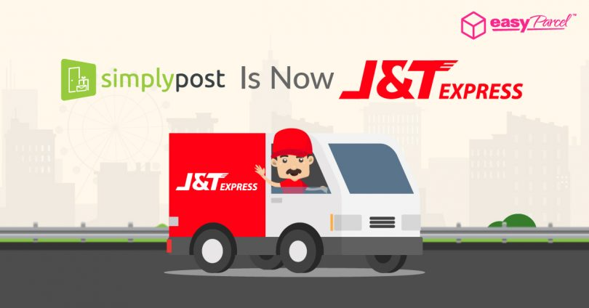
Table of contents
Part 1
1.1 introduction
1.2 problems of existing system
1.3 software quality attributes of the project
1.4 software Process model – rad model
1.4.1 Justification
1.4.2 advantages & disadvantages of rad model
1.4.3 phases of rad model

Slide 3

introduction
J&T Express is an Indonesian logistics company and its generally engaged in logistics and package delivery.
J&T uses automated sorting warehouses in Indonesia and Singapore. As of June 2017, it was valued at 543 million dollars.
J&T Express provide fast pick-ups and delivery services. Their sustainability in implementing advanced IT management system improves the world express delivery services and customer service qualities with fastest, most convenient and efferent claims.

Slide 4

CEO
Har Chun Wai
CFO
Lau Jun Dian
Graphic Designer
Nee Mei Yi
Programmer
Tan Kang Hong
Marketing Manager
Cheng Cai Jie

Slide 5
Problems of Existing System
Human error
Customer service
Lack of Automation function.
In terms of logistics, manual analysis and coordination by employees are very time-consuming and laborious tasks, so certain amount of human error is prone to occur.
In case of functions such as creating transportation routes, loading plans, and assigning goods to carriers were operated manually, some errors made by the employees may occur, this may affect the image of the company and also the customer’s experience.
Customers can know the delivery location completely transparently at all times.
Provide 24-hour customer service to reduce customer errors.
software solution can process data without errors and can operate without delay.

Slide 6
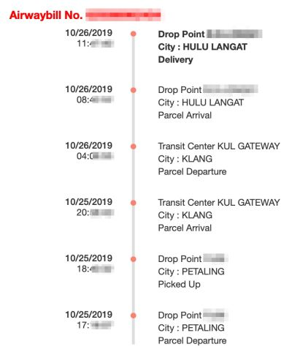
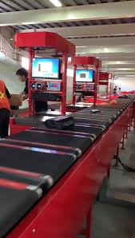


Slide 7
Software Quality Attributes
Efficiency
The performance shows the capability of the system in the form of responsiveness to certain operations within a specified time to measure in term of the time required to complete the task given by the system
It is responsible for the system to continue operating within a predetermined time.
Reliability
A system can measure if the product is reliable enough to sustain in any condition.
The system can be seen as reliable if the system test produces a low error rate.
Maintainability
The system shall be uncomplicated to add codes to the existing system.
The system maintenance should be cost-effective to easy correct errors or bugs or make some changes to the software.
Integrity
It is responsible for prevent unwarranted access to system functions.
It is responsible for the system's ability to reduce the possibility of information being stolen or lost.

Slide 8
software Process model (rad model)
Rapid Application Development model (or RAD model)
It is a development model that prioritizes rapid prototyping and rapid feedback in a long development and testing cycle.
Through rapid application development, developers can quickly iterate and update software multiple times without having to start the development schedule from scratch each time.
Initially, rapid application development took the form of a spiral model, where one or more development models are used for specific projects. It adapted to the needs of the time, while retaining some core development guidelines.

Slide 9
software Process model (rad model) - Justification
It is used to build a product that can be modularized in 2 or 3 months, which is faster compared to other process models.
Compared with others software process models, it is relatively cheap, but in some cases, it could be expensive.
If you are under pressure to deliver a workable product, do not have time for lengthy requirements planning and design phases then choosing the RAD platform may be the best choice. Rapid application development uses a dynamic approach, which makes sense for rapid development because it can change direction quickly.

Slide 10
software Process model (rad model) – Advantages & DIsAdvantages of RAD model
Advantages
DIsAdvantages
To reduce the overall project risk
Quicker delivery and high quality
Flexible and adaptable to changes
Time between prototypes and iterations is short
Encourages and priorities customer feedback
Too dependent on highly skilled developers
Needs user requirement throughout the life cycle of the product
Needs strong team collaboration
More complex to manage when compared to other models
Cannot work with large teams

Slide 11
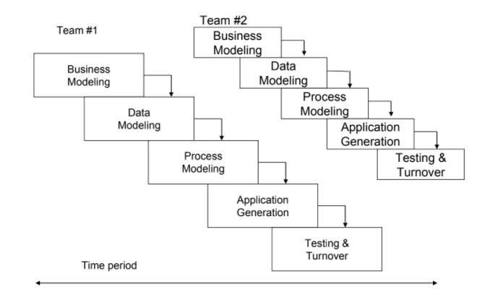
software Process model (rad model) – phases Diagram of rad model

Slide 12
software Process model (rad model) – phases of rad model
Phase 1: Business modeling
Obtains information from company information collected through many business-related sources.
Reviewed and analyzed to define a set of clear data objects crucial for the business that gathered during the business modeling phase.
All the information groups collected in the data modeling step will be converted into the required usable information.
It is possible to get a complete picture of business process functionality.
Phase 2: Data modeling
These models are sued to aid logistics managers in their attempts to design system to cope with the future.
Phase 3: Process modeling
Any changes or enhancements to the data objects are defined in this phase to establish business information flow.

Slide 13
software Process model (rad model) – phases of rad model
Phase 4: Application generation
To encode all the information collected and build the system that will be used to create the prototype.
Phase 5: Testing and Turnaround
Reduce the overall test time for creating a prototype.
The created data model will be transformed into an actual prototype, which will be tested in the next step.
Each model is individually tested to quickly identify and adjust components to create the most effective product.

Slide 14

The end
Thank for listening

